Slide 1

The Workforce Shortage in Long-Term Care:
Evidence, Implications, and Advocacy Opportunities
Stephen Campbell, Data and Policy Analyst, PHI
Sarah Slocum, Co-Director of the Program to Improve Eldercare, Altarum Institute
© PHI 2020
  December 14, 2020

Slide 2




Agenda
Snapshot of the Direct Care Workforce
Advocacy Opportunities to Strengthen the Workforce
Michigan’s Long-Term Care Workforce:
Needs, Strengths, and Challenges
© PHI 2020
  The Workforce Shortage in Long-Term Care • December 14, 2020

Slide 3

Snapshot of the Direct Care Workforce
© PHI 2020
  The Workforce Shortage in Long-Term Care • December 14, 2020

Slide 4

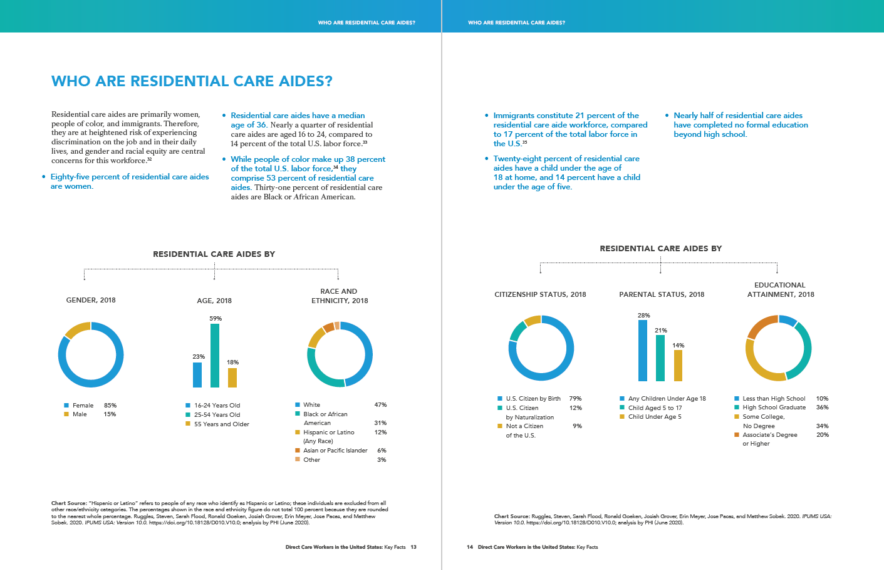
An Overview of the Direct Care Workforce
© PHI 2020
  The Workforce Shortage in Long-Term Care • December 14, 2020

Slide 5
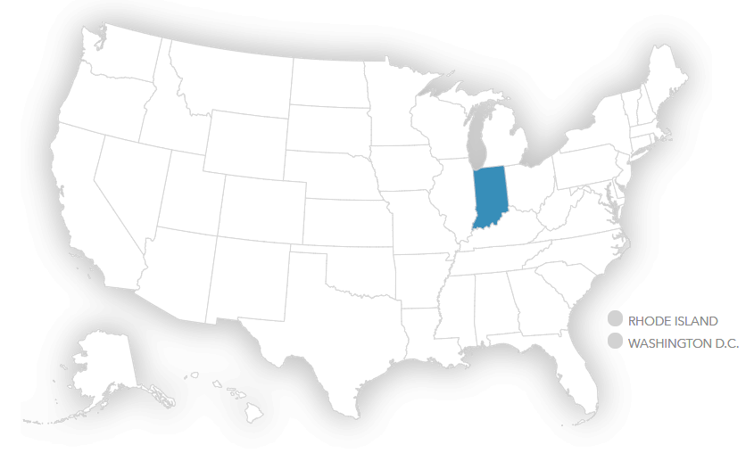
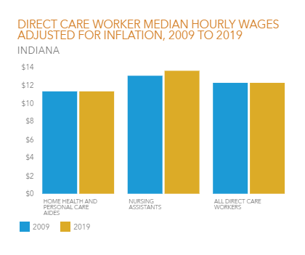
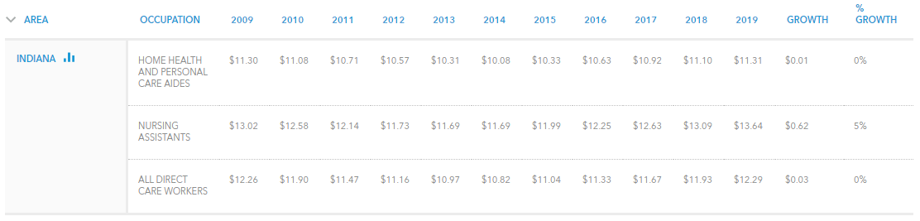
An Overview of the Direct Care Workforce
PHI Workforce Data Center
phinational.org/workforce-data-center
© PHI 2020
  The Workforce Shortage in Long-Term Care • December 14, 2020

Slide 6
An Overview of the Direct Care Workforce
The direct care workforce is growing rapidly.
PHI. “Workforce Data Center.” Last modified September 14, 2020. https://phinational.org/policy-research/workforce-data-center/.
© PHI 2020
  The Workforce Shortage in Long-Term Care • December 14, 2020

Slide 7
An Overview of the Direct Care Workforce
The direct care workforce is growing rapidly.
PHI. “Workforce Data Center.” Last modified September 14, 2020. https://phinational.org/policy-research/workforce-data-center/.
© PHI 2020
  The Workforce Shortage in Long-Term Care • December 14, 2020

Slide 8



An Overview of the Direct Care Workforce
Three primary factors contribute to rising.
Growing Population of Older Adults
Consumer Preferences
for Care
Policy and Programmatic Changes
© PHI 2020
  The Workforce Shortage in Long-Term Care • December 14, 2020

Slide 9
An Overview of the Direct Care Workforce
Most direct care workers are women, people of color, and immigrants.
87 percent are women
59 percent are people of color
27 percent are immigrants
PHI. “Workforce Data Center.” Last modified September 14, 2020. https://phinational.org/policy-research/workforce-data-center/.
© PHI 2020
  The Workforce Shortage in Long-Term Care • December 14, 2020

Slide 10



An Overview of the Direct Care Workforce
Direct care workers earn poverty wages.
Wages were $12.80 in 2019, compared to $12.61 in 2009
1 in 3 works part time
Their median annual earnings are $20,300
PHI. “Workforce Data Center.” Last modified September 14, 2020. https://phinational.org/policy-research/workforce-data-center/.
© PHI 2020
  The Workforce Shortage in Long-Term Care • December 14, 2020

Slide 11
An Overview of the Direct Care Workforce
Poor compensation causes immense economic instability for direct care workers.
45 percent live in or near poverty
47 percent access some form of public assistance
15 percent lack health insurance
PHI. “Workforce Data Center.” Last modified September 14, 2020. https://phinational.org/policy-research/workforce-data-center/.
© PHI 2020
  The Workforce Shortage in Long-Term Care • December 14, 2020

Slide 12
An Overview of the Direct Care Workforce
There are disparities based on race and gender within the direct care workforce.
Scales, Kezia. 2020. It’s Time to Care: A Detailed Profile of America’s Direct Care Workforce. Bronx, NY: PHI. https://phinational.org/caringforthefuture/itstimetocare/.
© PHI 2020
  The Workforce Shortage in Long-Term Care • December 14, 2020

Slide 13
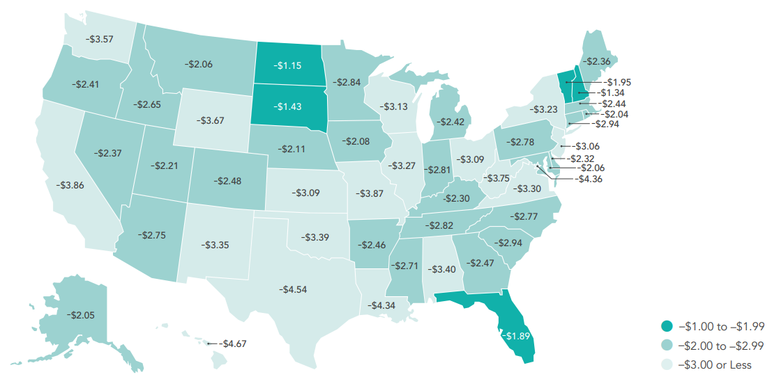
An Overview of the Direct Care Workforce
Direct care worker wages are lower than wages for occupations with similar entry-level requires in all 50 states and D.C.
Espinoza, Robert. 2020. Would You Stay? Rethinking Direct Care Job Quality. Bronx, NY: PHI. https://phinational.org/caringforthefuture/wouldyoustay/.
© PHI 2020
  The Workforce Shortage in Long-Term Care • December 14, 2020

Slide 14
An Overview of the Direct Care Workforce
From 2018 to 2028, the direct care workforce will add more new jobs than any single occupation.
PHI. 2020. Direct Care Workers in the United States: Key Facts. Bronx, NY: PHI. https://phinational.org/resource/direct-care-workers-in-the-united-states-key-facts/.
© PHI 2020
  The Workforce Shortage in Long-Term Care • December 14, 2020

Slide 15
An Overview of the Direct Care Workforce
From 2018 to 2028, the direct care workforce will have more total job openings than any other occupation.
PHI. 2020. Direct Care Workers in the United States: Key Facts. Bronx, NY: PHI. https://phinational.org/resource/direct-care-workers-in-the-united-states-key-facts/.
© PHI 2020
  The Workforce Shortage in Long-Term Care • December 14, 2020

Slide 16

Advocacy Opportunities to Strengthen the Workforce
© PHI 2020
  The Workforce Shortage in Long-Term Care • December 14, 2020

Slide 17

Advocacy Opportunities to Strengthen the Workforce
LAUNCH AN ADVOCACY CAMPAIGN
© PHI 2020
  The Workforce Shortage in Long-Term Care • December 14, 2020

Slide 18

Advocacy Opportunities to Strengthen the Workforce
CONSIDER MONETARY AND NON-MONETARY SOLUTIONS
© PHI 2020
  The Workforce Shortage in Long-Term Care • December 14, 2020

Slide 19

Advocacy Opportunities to Strengthen the Workforce
Espinoza, Robert. 2020. Would You Stay? Rethinking Direct Care Job Quality. Bronx, NY: PHI. https://phinational.org/caringforthefuture/wouldyoustay/.
© PHI 2020
  The Workforce Shortage in Long-Term Care • December 14, 2020

Slide 20

Advocacy Opportunities to Strengthen the Workforce
CONVENE A STATEWIDE WORKGROUP
© PHI 2020
  The Workforce Shortage in Long-Term Care • December 14, 2020

Slide 21

Advocacy Opportunities to Strengthen the Workforce
COMMISSION A WORKFORCE STUDY
© PHI 2020
  The Workforce Shortage in Long-Term Care • December 14, 2020

Slide 22



MICHIGAN’S
LONG-TERM CARE
WORKFORCE
NEEDS, STRENGTHS, & CHALLENGES
SARAH SLOCUM
CO-DIRECTOR, PROGRAM TO IMPROVE ELDERCARE, ALTARUM
ANI TURNER
CO-DIRECTOR OF SUSTAINABLE HEALTH SPENDING STRATEGIES, ALTARUM
STEPHEN CAMPBELL
DATA AND POLICY ANALYST, PHI
KEZIA SCALES
DIRECT OF POLICY RESEARCH, PHI
  DECEMBER 14, 2020

Slide 23


Study Origins
Michigan Caring Majority Coalition advocacy for LTSS study
Multiple legislative meetings/calls
Two attempts – first stand-alone legislation then budget bill
Cultivated legislative “Care Champions” along the way
Resources and back up from Caring Across Generations
  MICHIGAN’S LONG-TERM CARE WORKFORCE • DECEMBER 14, 2020

Slide 24
Study Structure
State Appropriations Bill Language
Actuarial Study of Individual LTSS Benefit Options – Milliman
Study of LTSS Workforce – PHI and Altarum
  MICHIGAN’S LONG-TERM CARE WORKFORCE • DECEMBER 14, 2020

Slide 25
Study Implementation
Michigan Department of Health and Human Services responsible for completion of study
Stakeholder group to advise study – advocates, workers, providers
Funding - $100,000 state tax funds; $200,000 Michigan Health Endowment Fund; $100,000 Ralph C. Wilson Jr. Foundation
  MICHIGAN’S LONG-TERM CARE WORKFORCE • DECEMBER 14, 2020

Slide 26
Our Approach
Quantitative Analysis
Key Informant Interviews
Listening Sessions and Individual Interviews
  MICHIGAN’S LONG-TERM CARE WORKFORCE • DECEMBER 14, 2020

Slide 27
KEY FINDINGS:
MICHIGAN’S LTC WORKFORCE PROFILE
  MICHIGAN’S LONG-TERM CARE WORKFORCE • DECEMBER 14, 2020

Slide 28
KEY FINDINGS:
PROJECTED GROWTH BY OCCUPATION IN MICHIGAN, 2016 TO 2026
  MICHIGAN’S LONG-TERM CARE WORKFORCE • DECEMBER 14, 2020

Slide 29
KEY FINDINGS:
ANNUAL TURNOVER BY DIRECT CARE OCCUPATION IN MICHIGAN, 2014 TO 2018
  MICHIGAN’S LONG-TERM CARE WORKFORCE • DECEMBER 14, 2020

Slide 30
KEY FINDINGS:
PROJECTED TOTAL JOB OPENINGS BY OCCUPATION IN MICHIGAN, 2016 TO 2026
  MICHIGAN’S LONG-TERM CARE WORKFORCE • DECEMBER 14, 2020

Slide 31
KEY CHALLENGES:
THE LICENSED PROFESSIONAL WORKFORCE
Providers able to fill licensed positions for now, but concern about future
Small candidate pools
LTC must compete with other health settings, some with higher wages
Difficulty finding PTs and OTs in UP
Projected LPN shortage in MI by 2030
  MICHIGAN’S LONG-TERM CARE WORKFORCE • DECEMBER 14, 2020

Slide 32
KEY CHALLENGES:
THE DIRECT CARE WORKFORCE
High demand for services paired with low supply of workers
Poverty wages and poor job quality compel workers to leave their jobs
Training is inconsistent in the field
Shortages are difficult to assess due to data limitations
  MICHIGAN’S LONG-TERM CARE WORKFORCE • DECEMBER 14, 2020

Slide 33

Recommendation
Improve compensation for Michigan’s direct care workforce.
  Provide a family-sustaining wage
  Require racial and gender-based equity
  Promote full-time hours
  Provide workers with benefits
  MICHIGAN’S LONG-TERM CARE WORKFORCE • DECEMBER 14, 2020

Slide 34
Recommendation
Invest in direct care workforce recruitment and retention in Michigan.
  Convene a standing body of diverse stakeholders – progress!
  Establish an innovation fund
  Launch a program to recruit, train, and deploy new workers
  Establish a matching service registry – progress!
  MICHIGAN’S LONG-TERM CARE WORKFORCE • DECEMBER 14, 2020

Slide 35
Recommendation
Strengthen training for direct care workers across long-term care settings and programs in Michigan.
  Mandate high-quality training curricula
  Enact a credentialing system
  Designate funds for entry-level training and advanced roles
  MICHIGAN’S LONG-TERM CARE WORKFORCE • DECEMBER 14, 2020

Slide 36
Recommendation
Strengthen long-term care workforce data collection and reporting in Michigan.
  Collect detailed data on the size and compensation of the direct workforce
  Measure long-term care workforce stability and shortage indicators
  Publish workforce data and make them widely available
  MICHIGAN’S LONG-TERM CARE WORKFORCE • DECEMBER 14, 2020

Slide 37
KEY CHALLENGES:
CARE RECIPIENTS AND THEIR CAREGIVERS
  Recipients want to remain at home with control over own life and care
  Physical and emotional toll on family caregivers
  Extremely difficult to finance and navigate care
  Difficult to recruit and retain direct care workers
  MICHIGAN’S LONG-TERM CARE WORKFORCE • DECEMBER 14, 2020

Slide 38
Recommendation
Improve navigation assistance for Michigan’s family caregivers.
  Review and assess strengths and weaknesses of information sources
  Pilot new models of navigation assistance
  Engage community resources to enhance their ability to distribute information to families
  MICHIGAN’S LONG-TERM CARE WORKFORCE • DECEMBER 14, 2020

Slide 39
Recommendation
Create new funding and benefit structures to support family caregivers in Michigan.
  Develop new benefit options
  Create income-replacement mechanisms
  Institute protections from foreclosure and eviction
  Engage employers in devising new benefits and protections
  MICHIGAN’S LONG-TERM CARE WORKFORCE • DECEMBER 14, 2020

Slide 40
Recommendation
Devise additional supports for Michigan’s family caregivers to improve their physical and mental/emotional health.
  Publicize new and existing family caregiver supports
  Assess capacity of current supports and develop a plan to quickly address shortfalls in support services
  Educate health care professionals about recognizing caregiving issues
  MICHIGAN’S LONG-TERM CARE WORKFORCE • DECEMBER 14, 2020

Slide 41
Recommendation
Devise additional supports for Michigan’s family caregivers to improve their physical and mental/emotional health. (Cont’d)
  Create a toll-free hotline for family caregivers
  Identify local culturally relevant resources for caregivers and publicize them through familiar social or faith-based entities
  MICHIGAN’S LONG-TERM CARE WORKFORCE • DECEMBER 14, 2020

Slide 42

Stephen Campbell
Title Data and Policy Analyst
PHI
scampbell@phinational.org
Sarah Slocum
Co-director, Program To Improve Eldercare
Altarum Institute
sarah.slocum@altarum.org
400 East Fordham Road, 11th Floor • Bronx, New York 10458 • www.PHInational.org
© PHI 2020

